Slide 1
FreeRTOS introduction AJ Chen
March 11th, 2015

Slide 2
Agenda
RTOS
FreeRTOS Directory
FreeRTOS structure
Task
Communication(queue)
Interrupt
MemMang
FreeRTOS Config Setting
Q&A

Slide 3
RTOS
Real-Time Operating System
Multi-Task
Event-driven/ Time-sharing
Accuracy
Concerning the amount of time
Immediate interrupt handler
Hard Real Time
RTOS can meet a deadline deterministically
Soft Real Time
RTOS that can usually or generally meet a dadline.

Slide 4
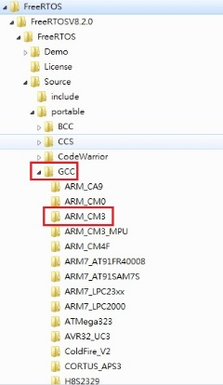
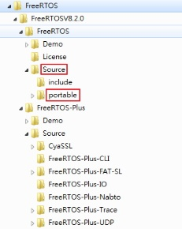
FreeRTOS Directory
Foucus on folder “Source”
Check “portable” to select compiler too and witch MCU you used

Slide 5
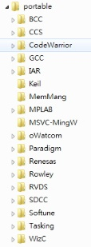
FreeRTOS Directory
Main files for source code
Source/tasks.c
Source/Queue.c
Source/List.c
Source/portable/[compiler]/[processor]/port.c
Source/portable/MemMang/heap_1.c
MemMang contain sample heap implementations

Slide 6
FreeRTOS
Source Code

Slide 7
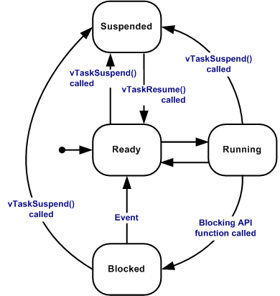
Task
Running
currently utilizing the processor
Ready
able to execute
not currently executing
Suspended
vTaskSuspend()
xTaskResume()
Blocked
vTaskDelay()
waiting for queue and semaphore events

Slide 8
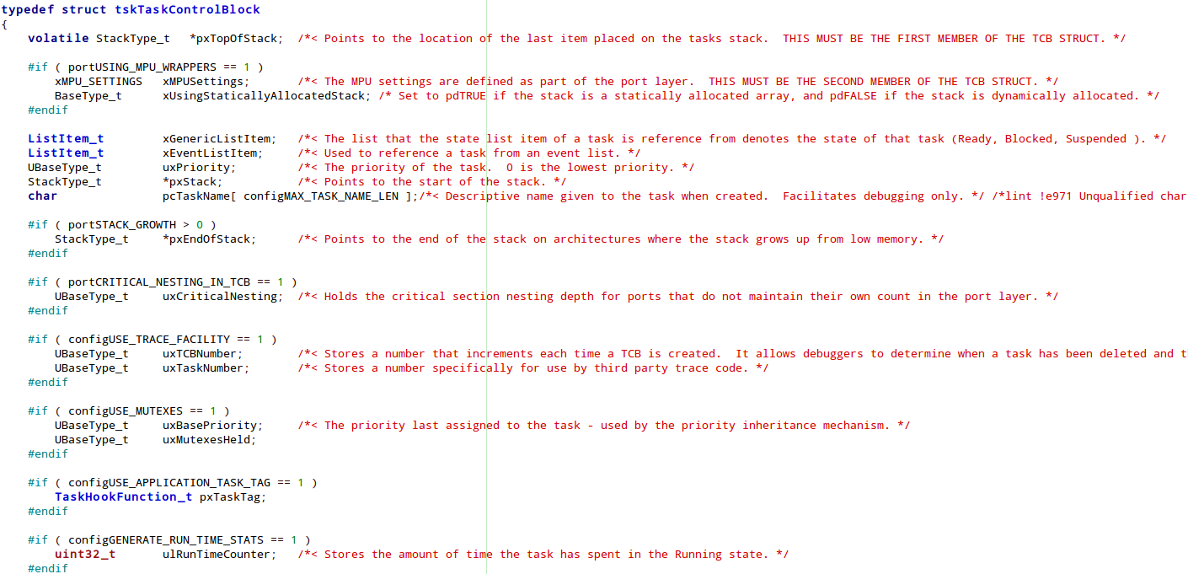
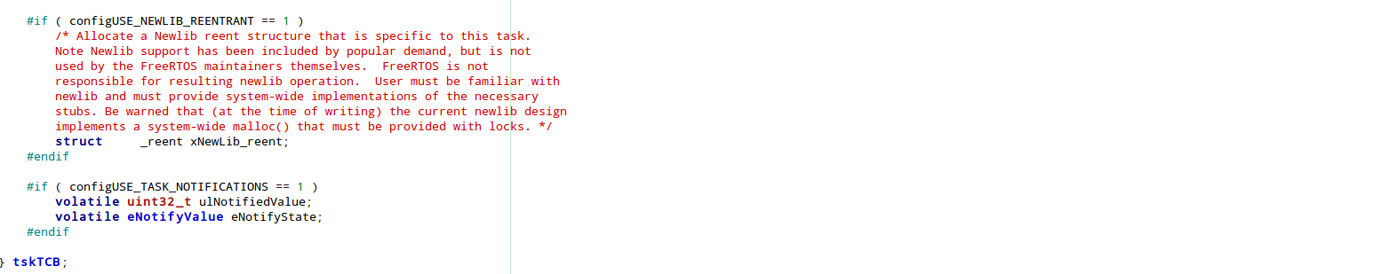
Task TCB

Slide 9
Queue
Communicate between tasks
xQueueSendToBlock()
xQueueRecive()
Implement mutex and semaphore

Slide 10
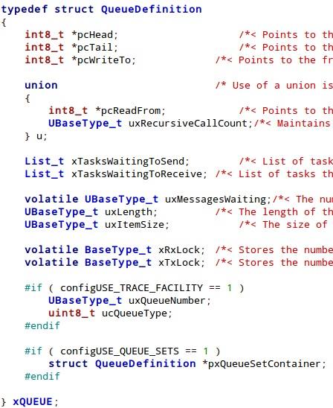
Queue

Slide 11
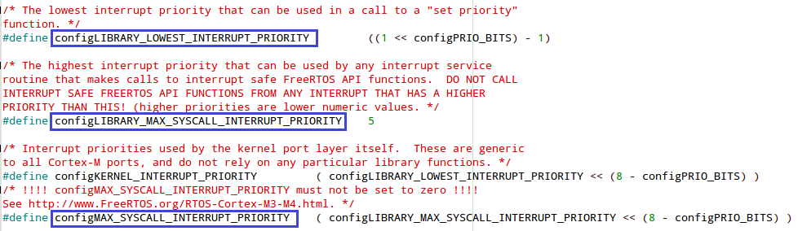
Interrupt
Zero is the highest interrupt priority.
configMAX_SYSCALL_INTERRUPT_PRIORITY can not be set to zero.
Setting in config file and relate function in port.c

Slide 12
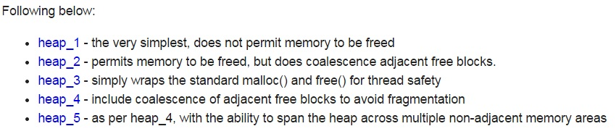
MemMang
heap management (Basic fuction below)
pvPortMalloc( size_t xWantedSize )
pvPortFree( void *pv )
/Source/portable/MemMang/

Slide 13
FreeRTOS
FreeRTOS Config

Slide 14
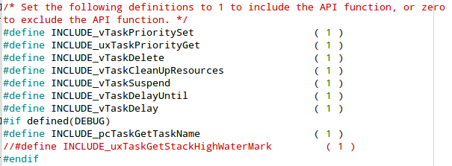
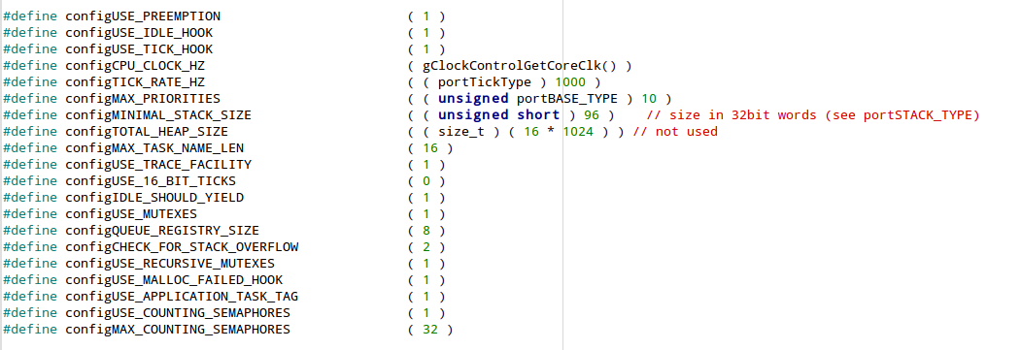
FreeRTOS Config
Chosen API you needed
Selection HW requirment

Slide 15
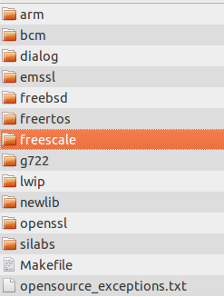
Start FreeRTOS
Download FreeRTOS source code
if you are using the GCC compiler you can use FreeRTOS/Source/portable/GCC directory
See existing port.c and portmacro.h files for a list of such functions and macros.
Check existing sample FreeRTOSConfig.h
Implement/modify FreeRTOSConfig.h
Implement function you needed

Slide 16
Q&A
Thanks for your time

